Slide 1
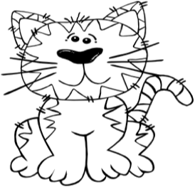
Macclenny Elementary
1st Grade Supply List
Please Do NOT label items. These will be used for the classroom.
Supply List
5 boxes of crayons (24 count)
2 packs of 24 yellow #2 pencils
1 pair of scissors
2 packs of glue sticks
2 plastic folder with pockets and prongs
2 solid colored spiral notebooks
1 plastic (8in x 5in) pencil box
1 backpack
1 school planner (may be purchased at MES)
Wish List Items:
Clorox Wipes
Hand Sanitizer
Box of tissues
***Each individual teacher may have additional
items requested.***

